Slide 1

Enable CI Collaboration in Southeast Asia: NSC SEAIP support to BioCI
Common Interests and threats in the region
Provide a Conduit for the most updated ICT development.
Share Experiences & Incubate Collaboration.
Connect ICT & Science
Common problems in the region, such as problems in Natural Disasters , Biodiversity & many others.
Build Trust: Rich and diverse cultures that can be shared to enhance the mutual understanding.

Slide 2
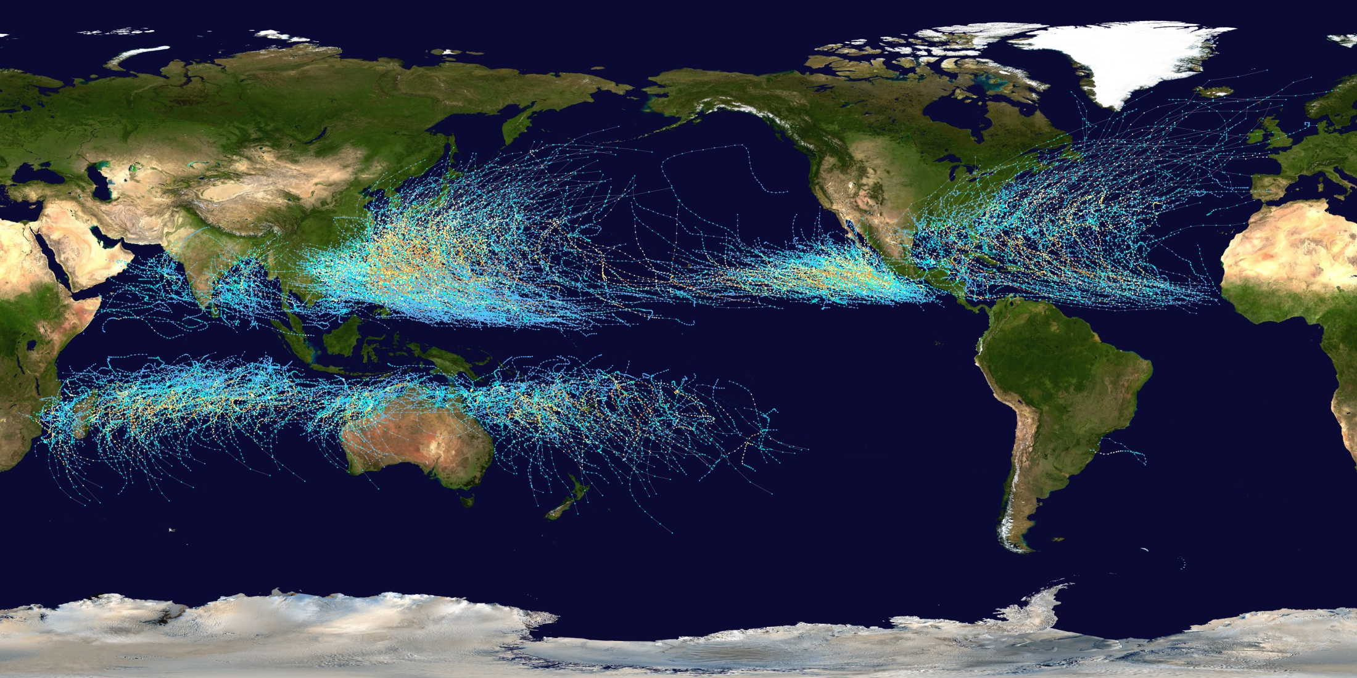
Typhoon Tracks 1980~2005

Slide 3
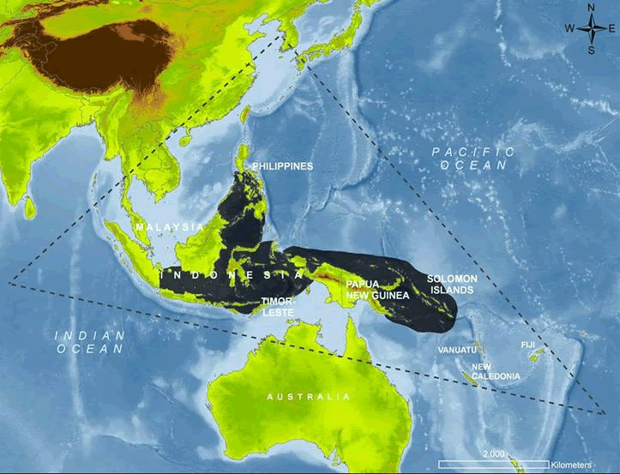
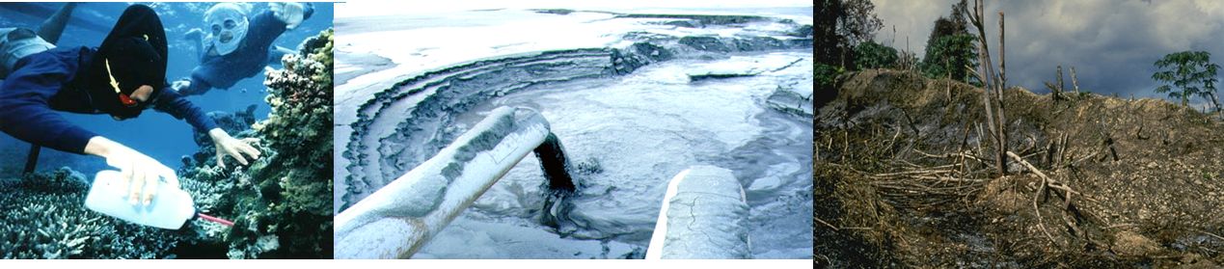
Biodiversity: Coral triangle
Source: WWF

Slide 4
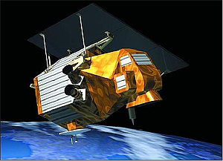
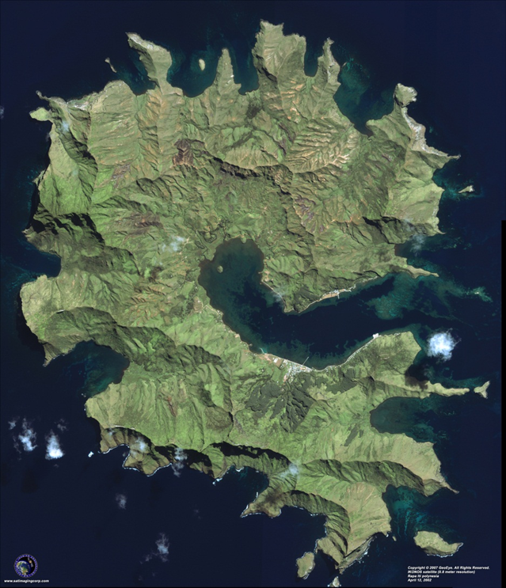
Formosat 2 – NSPO, Taiwan
Imaging Data Products | • B&W: 2-m • Color: 2-m (merge) • Multispectral (R, G, B, NIR): 8-m • Bundle (separate Pan and MS images)
Spectral Bands | • P: 0.45 - 0.90 µm (Panchromatic) • B1: 0.45 - 0.52 µm (Blue) • B2: 0.52 - 0.60 µm (Green) • B3: 0.63 - 0.69 µm (Red) • B4: 0.76 - 0.90 µm (Near-infrared)
Sensor Footprint | 24 km x 24 km
Revisit Interval | Daily
Viewing Angles | Cross-track and along-track (forward/aft): +/- 45°
Satellite Tasking | Yes - Panchromatic and multispectral images can be acquired at the same time
Image Dynamics | 8 bits/pixel
Image File Size (level 1A without metadata) | • MS: 35 Mb • Pan: 137 Mb
IT & Application – Whey-Fone Tsai in Geoscience Working Group, PRAGMA

Slide 5
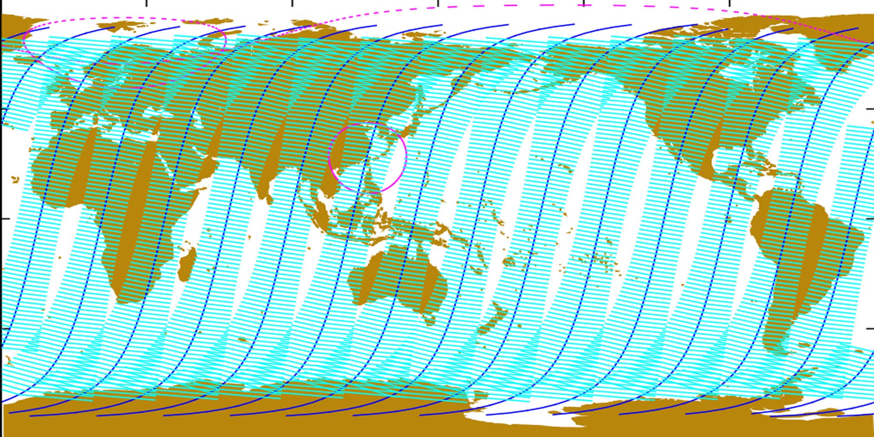
Map of FORMOSAT-2 orbits and coverage areas
Map of FORMOSAT-2 orbits and coverage areas (30° & 45 °): the satellite completes exactly 14 orbital revolutions every day
Source: NSPO

Slide 6
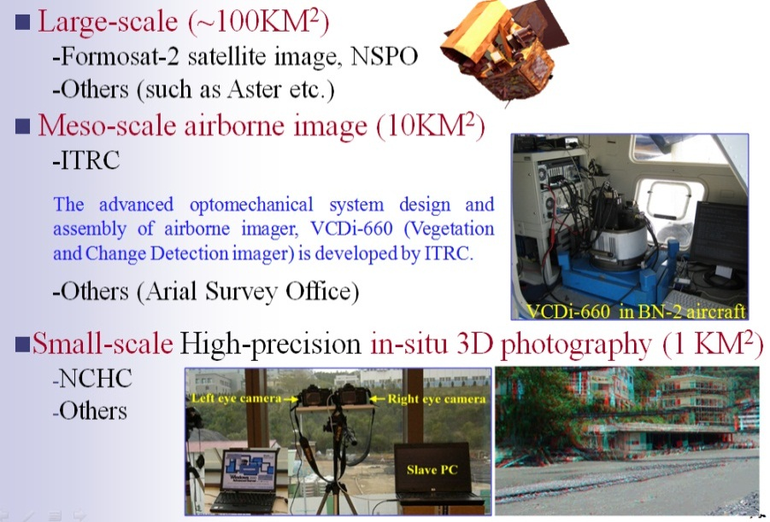
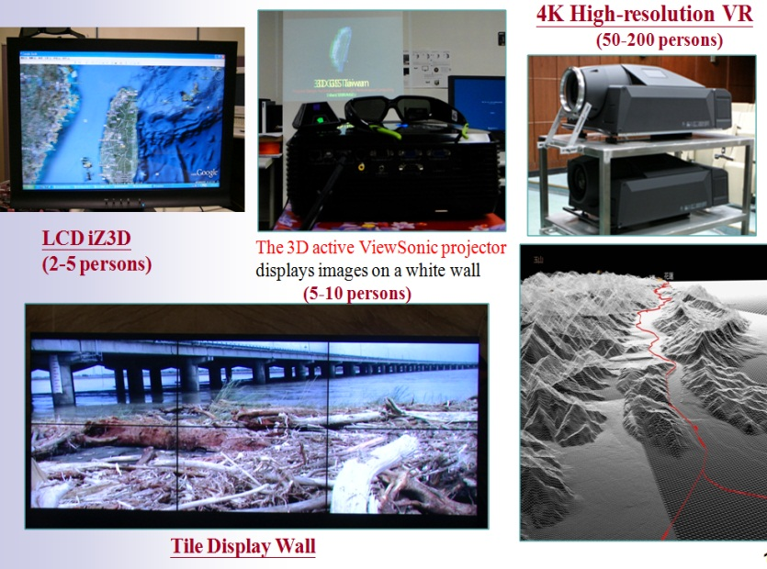
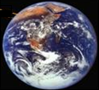
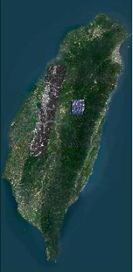
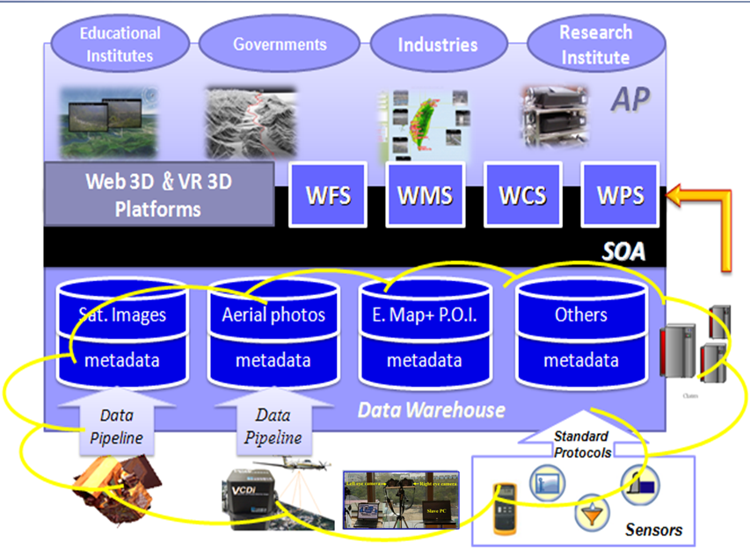
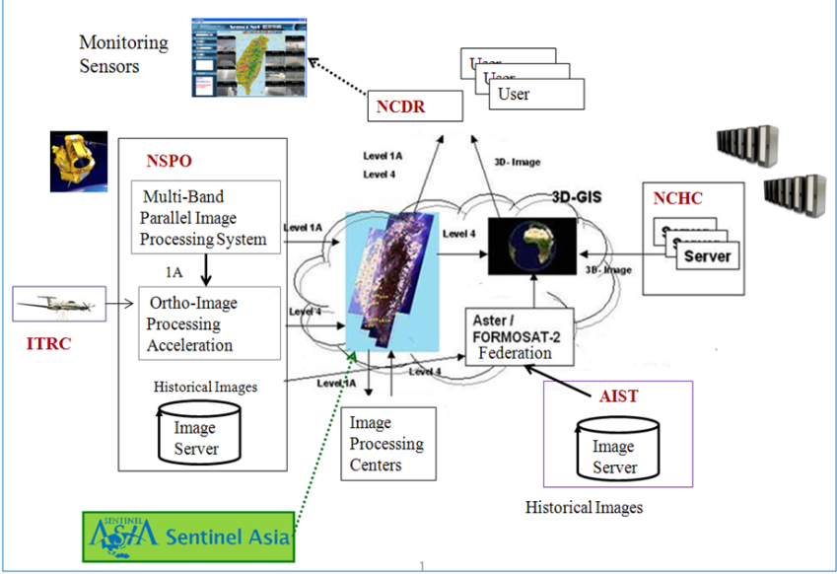
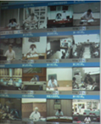
3D GIS Taiwan PI: Whey-Fone Tsai
Multiscale Observation
Visualization & Applications
Near-real time data processing & Decision support
3D GIS Cloud Servcies
以人為本

Slide 7
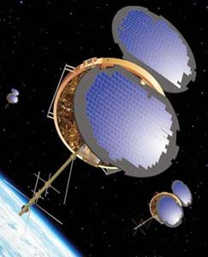
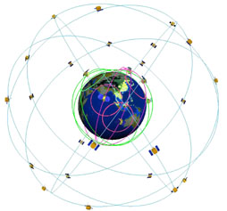
FORMOSAT-3/COSMIC (Constellation Observing System for Meteorology, Ionosphere & Climate)
Type / Application: Earth observing
Operator: NSPO / USAF STP (Space Test Program)
Contractors: Orbital Sciences Corporation (OSC)
Equipment:
Configuration: MicroStar
Propulsion:
Power: 2 deployable solar arrays, batteries
Lifetime:
Mass: 70 kg
Orbit: 700 km × 700 km, 72°
The satellite observation covers the entire global atmosphere and ionosphere, providing over 2,500 global sounding data per day.
The global climate information collection and analysis can be completed in three hours while the sounding data will be updated every 90 minutes
Source: NSPO

